Slide 1
Risk and the Growth of Shadow IT
Chris Ince
ISO 27001 Lead Auditor
Security Risk Management Ltd

Slide 2
What is Shadow IT?
“Shadow IT is IT activity that occurs outside of IT. Shadow IT is growing in many organisations driven by consumerized technology, mobility, the availability of cloud solutions …..”
Gartner

Slide 3
Shadow IT is not new and it’s not all about the cloud

Slide 4
There are those that use Shadow IT…
and those that don’t know they use Shadow IT

Slide 5
What is Shadow IT?
User maintained software
Webmail
Social Media
Employee owned hardware
Non-approved apps

Slide 6
How and why Shadow IT exists.
IT Management Traditionally Want
Control of all IT assets and information.
Protect Organisation Data
End Users Want
Flexible Solution
Faster Delivery
Reduce Business Risk
Greater Freedom

Slide 7
What are the Risks?
SAM compliance
Governance and standards
Lack of testing and change control
Configuration management

Slide 8
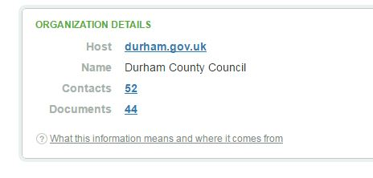
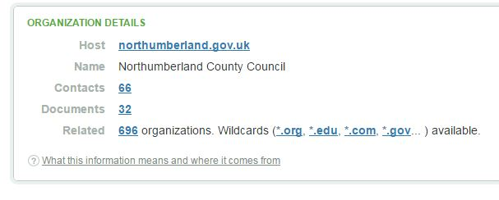
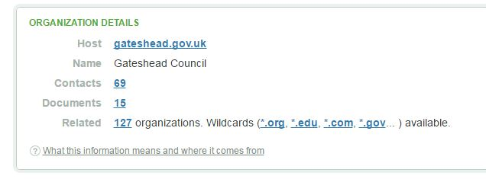
Some examples
Information for sale
Price to access information $1
Source relatelist.com

Slide 9
Educate users about the business risks?
Have you engaged with the business and understood their needs?
Information Governance requirements
Security requirements
Legal Requirements
Industry requirements
Do they understand the how to use the cloud safely?
Do they understand potential risk to themselves?

Slide 10
I’m sure we don’t have that Shadow IT stuff!
Have you looked?
Do you even know how to look?
Have you reviewed bills with procurement or finance?
Have you made use of a network scanning and detection tool? Shadow or Cloud Discover Tool
Have you checked your firewall or proxy reports?

Slide 11
Have you looked?
Cloud Security Alliance - Cloud_Adoption_Practices_Priorities_Survey_Final.pdf

Slide 12
You’ve looked and now know
Skyhigh Networks Cloud Adoption Risk Report Q4 2015

Slide 13
But what are they being used for?
Skyhigh Networks Cloud Adoption Risk Report Q4 2015

Slide 14
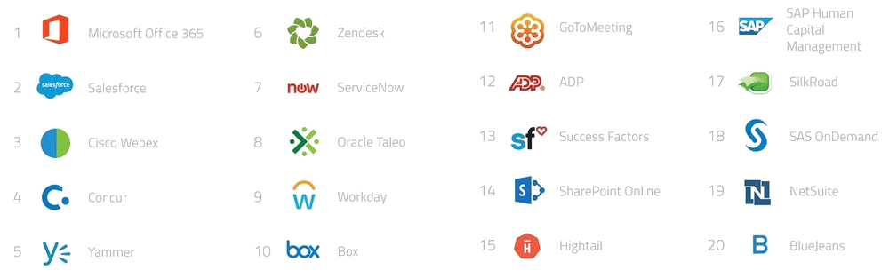
Top 20 Corporate Applications
Skyhigh Networks Cloud Adoption Risk Report Q4 2015

Slide 15
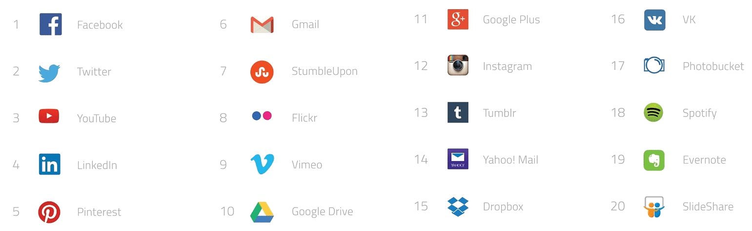
Top 20 Consumer Applications
Skyhigh Networks Cloud Adoption Risk Report Q4 2015

Slide 16
Getting the choice right
  Support 2FA
  Encrypt Data at rest
  Encrypt Data with customer managed keys
  Specify customer owns data uploaded
  Delete data immediately on account deletion
  Commit to not share data with 3rd parties
  Hold data in an EU Data centre
  Service Isolation

Slide 17
Keeping updated on what can be used
  Understand Market
  Functionality
  Contracts
  Compliance
  Tools to Help

Slide 18
Regulations, Directives and Compliance
  EU Cyber Security Directive (Early 2018)
  EU General Data Protection Regulation (Early 2018)
  EU-US Privacy Shield (June 2016)
  PCI-DSS
All come with a cost if you get them wrong.

Slide 19
Useful sources of information
BIS and PwC Information Security Breaches Survey
Skyhigh Cloud Adoption Risk Report Q4 2015
Bluecoat Elastica Shadow Data Report
Verison PCI compliance Report
Verison Data Breach report
Cloud Security Alliance
PCI-SCC

Slide 20


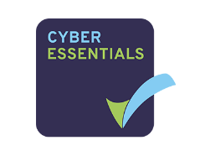


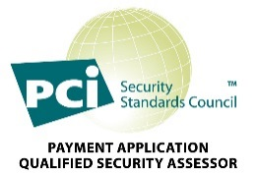
Thank You
Any Questions?
Chris Ince
ISO 27001 Lead Auditor
Security Risk Management Ltd

