Slide 1

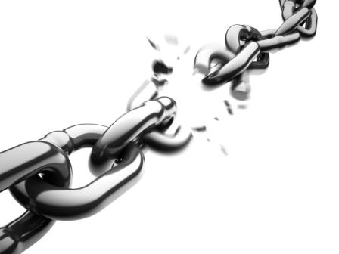

Slide 2












ISO Auditors
CERT-UK Champion for CiSP
BCI certified
Lloyds Quality Gold Consultants
BSI & ISO standard technical panels on Resilience
Cyber Essentials Assessors
ENISA Consultant
Fellow IET
UK Government Trusted Partner on EU Cyber Security Directive
GCHQ/EPSRC Cyber Research Institute
founder
LONDONDERRY GARAGE &
XLB SERVICES

Slide 3

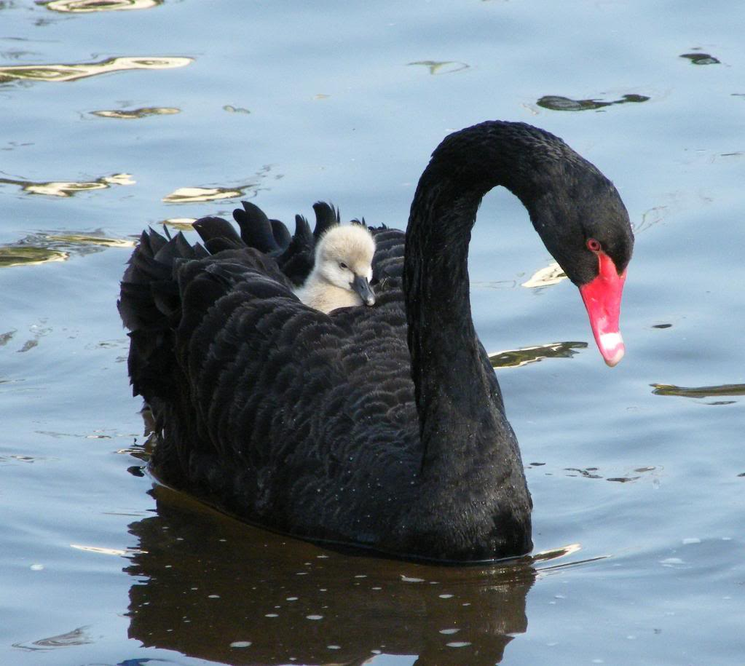

Slide 4
The Impacts
Repeat call attempts will inflate normal demand by 25% - 40% at peak
Pressure on the eCommerce functions will be overwhelming causing them to crash
Manual backlogs awaiting batch processing will mount
The ICO will be informed and as time goes on Councillors, MPs, Trustees and Governors will be regularly asking questions in the media, alongwith security experts!
If listed, a share price drop of circa 20%

Slide 5

The Cost Impacts
Response costs of £100 - £120 a record
500k records = £60m
Fines upto £10m for Cat 2 indiscretions (GDPR)
Possible tighter regulations
Select Committee appearances

Slide 6
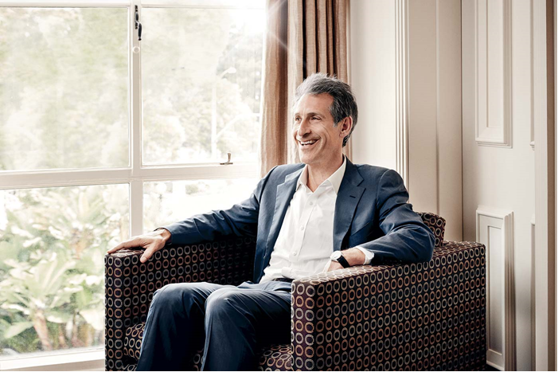

Sony CEO – Michael Lynton
“they tried to burn the house down”

Slide 8
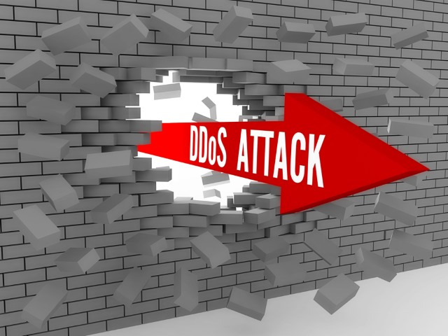

Low frequency 1Gbps
Attempts up from 3 to 4.5 per day
< 30mins duration
Continuous Monitoring is key

Slide 9
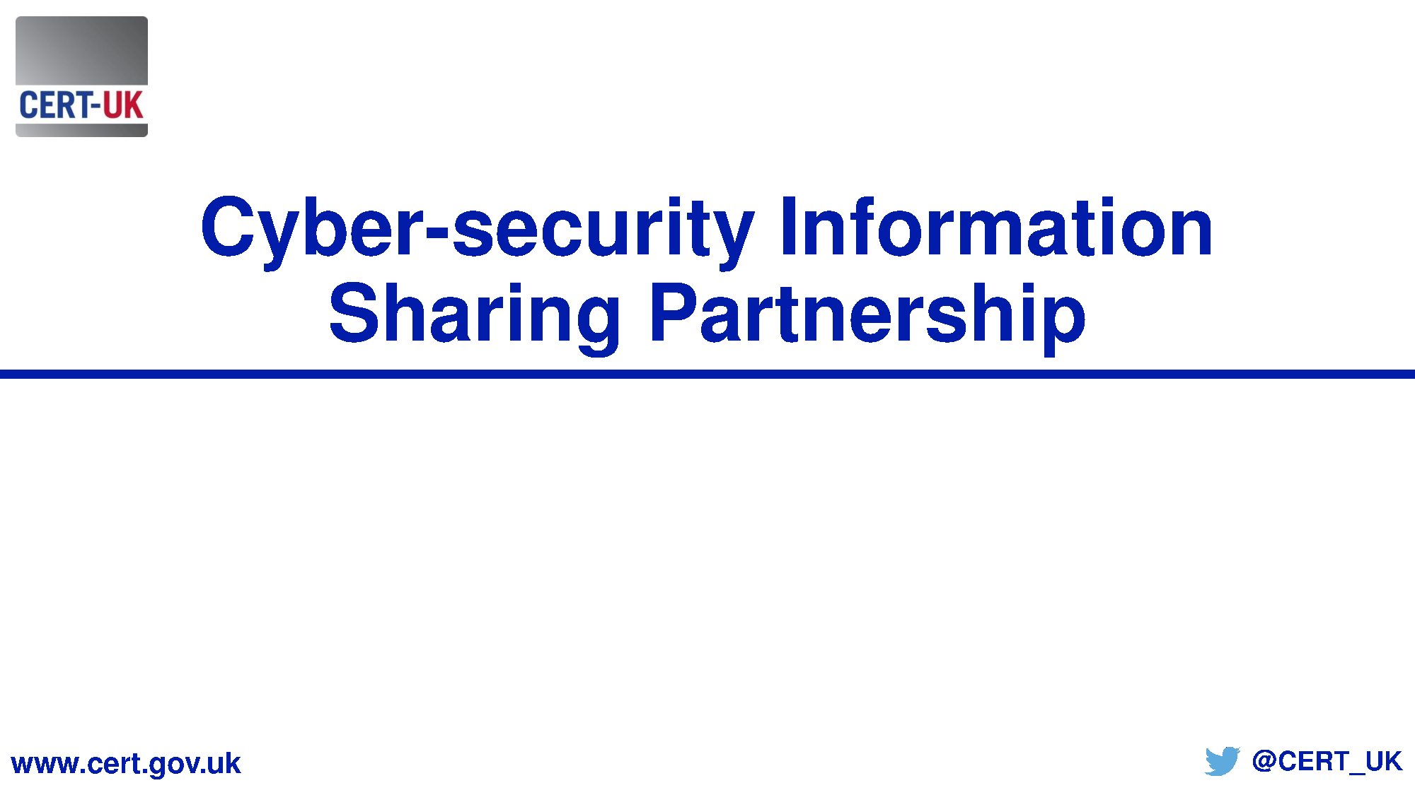

Slide 10
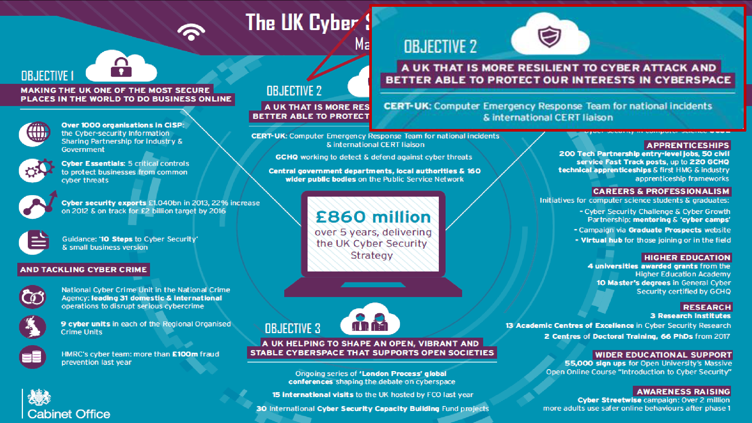

Slide 11
